Slide 1
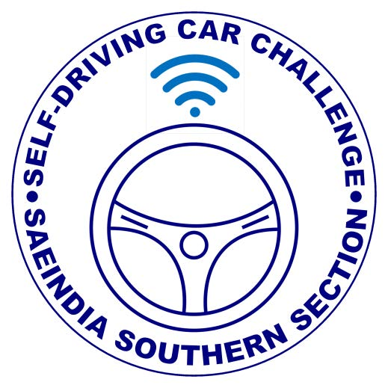
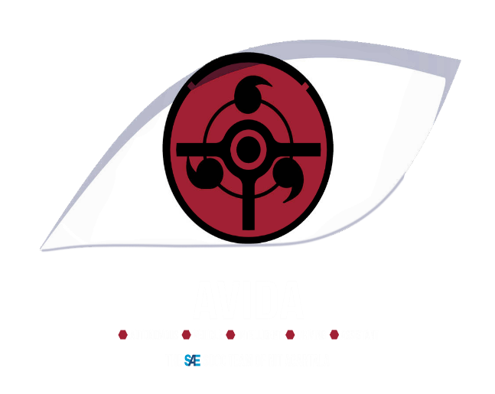
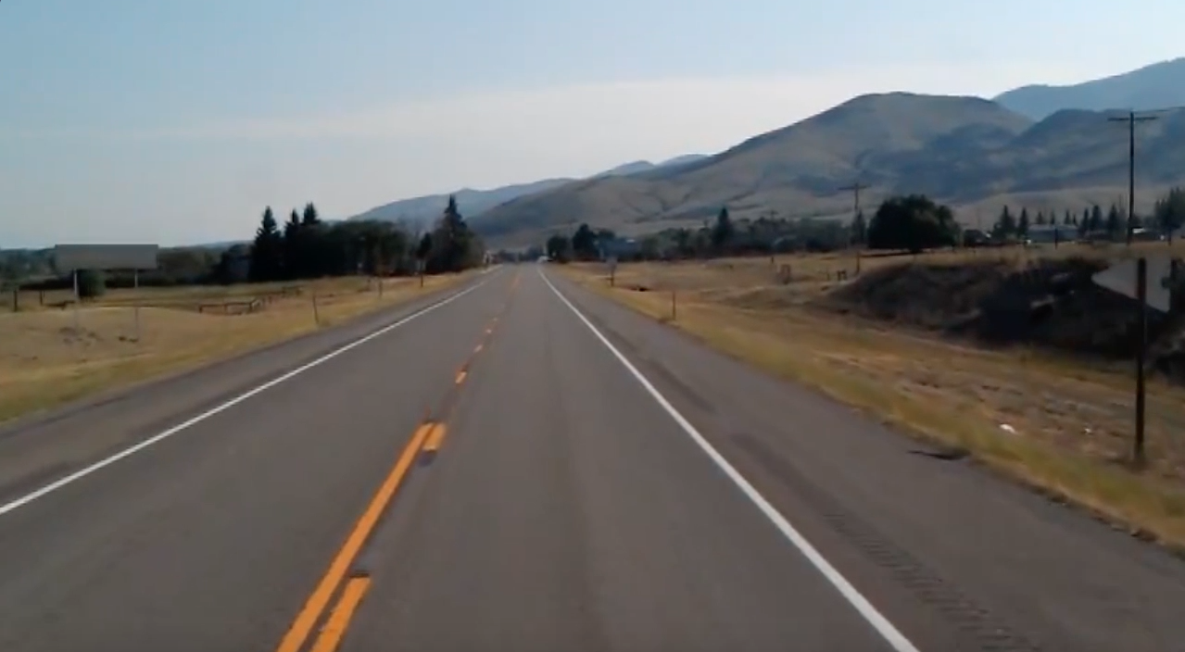
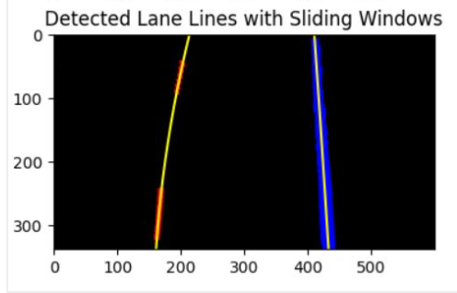
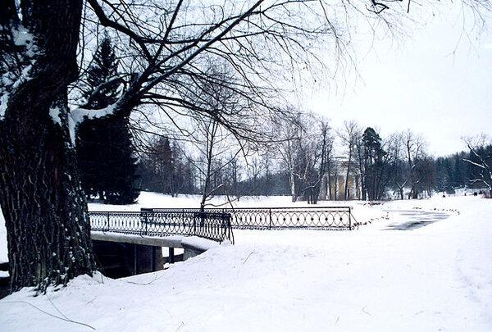
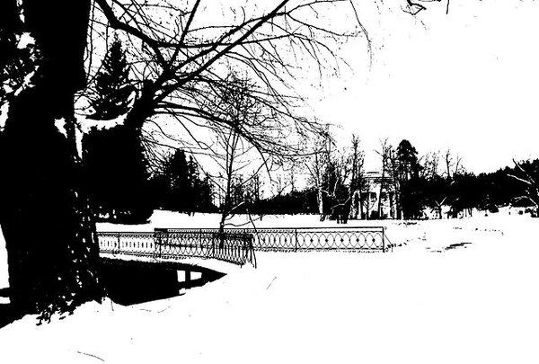
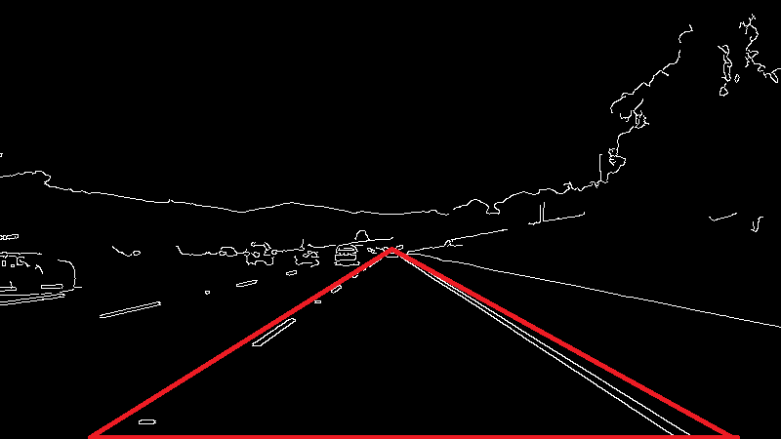
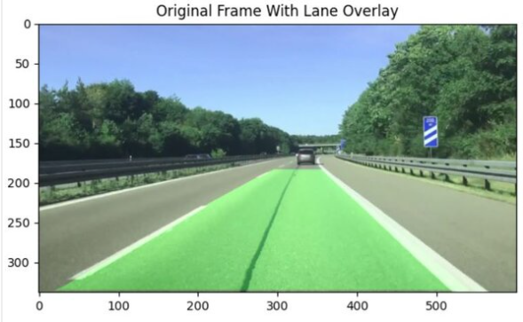
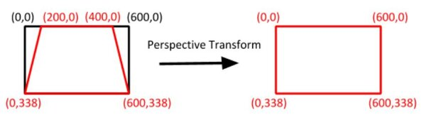
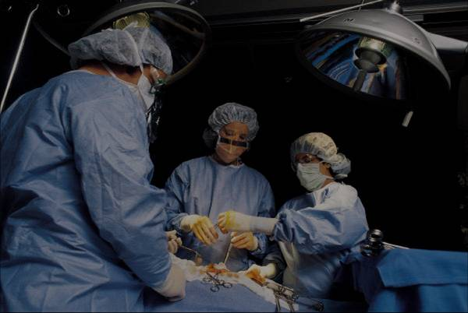
Lane Detection
Team AVIDA
Autonomous Vehicle in Intelligence Driving and Assistance
Shivansh Mishra, Hareesh M. ,Thanesh Bisen
Abstract
Methodology
The goal of this first project was to create a simple pipeline to detect road lines in a frame taken from a roof-mounted camera. Our goal is to create a program that can read a video stream and output an annotated video that shows the following:
The current lane
The radius of curvature of the lane
The position of the vehicle relative to the middle of the lane.
WORK FLOW
Methodology for program workflow follows:-
Thresholding- It is used to create binary images
Perspective Transform- It is used to generate Bird eye view images taken from car mounted perspective.
Identify Lane Pixels-We take help from Histogram to identify concentrated line pixels.
Sources-
https://medium.com/@yogeshojha/self-driving-cars-beginners-guide-to-computer-vision-finding-simple-lane-lines-using-python-a4977015e232
https://automaticaddison.com/the-ultimate-guide-to-real-time-lane-detection-using-opencv/
Thresholding
Perspective Transform
Lane Pixel Identification
Overlay of Detected Lanes on Raw Image
Introduction
The Automotive industry is currently experiencing a paradigm shift from conventional human-driven vehicles to autonomous self-driving vehicles. With it, Self-driving cars are constantly making the headlines. What seemed like a sci-fi movie decades back, is right now the reality. We now have vehicles that are designed to carry humans from point A to point B without any human intervention. Self Driving cars are one of the hottest areas of research and there is no doubt that self-driving cars are the future!
We, humans, are heavily dependent on our five senses to interpret what is going on around us. Every sense is equally important to us. Eyes are what we use to see and perceive a lot of things around us. It helps us to see the road around us, see the obstacle around us, identify the lanes and much more. In applications like autonomous vehicles, Robotics, this still is one of the most challenging tasks to teach machines to see and understand like humans.
Computer vision is one of the hottest topics in Artificial Intelligence. It is being used extensively in Robotics, Autonomous Vehicles, Image Classification, Object Detection & tracking, Semantic Segmentation as well as in various photo correction apps. In Autonomous vehicles, vision remains the main source of information to detect lanes, traffic lights, and other visual features.
Despite the challenges, we have already done so many advancements in the field of Computer Vision.
Conclusions
We were exposed to various Open-Source Libraries ad learned their Utilization and functioning
Overall we were able to use, understand and modify the code and implement it on raw image data to isolate lane line edges and lane lines.
Results
We calculated the curvature of the lane line and displayed it on the screen.
Then we calculated how far the center of the car is from the middle of the lane (i.e. the “center offset).
Figure 1. Image before Processing.
Fig. image thresholding
Contact
References
Team AVIDA
Email:
Website:
Phone:
https://automaticaddison.com/the-ultimate-guide-to-real-time-lane-detection-using-opencv/
https://medium.com/@yogeshojha/self-driving-cars-beginners-guide-to-computer-vision-finding-simple-lane-lines-using-python-a4977015e232
https://opencv.org/
https://www.geeksforgeeks.org/opencv-overview/
https://matplotlib.org/
https://www.geeksforgeeks.org/python-introduction-matplotlib/
https://numpy.org/
https://www.w3schools.com/python/numpy/numpy_intro.asp
Figure 2. Detected Lanes from image.

